Slide 1
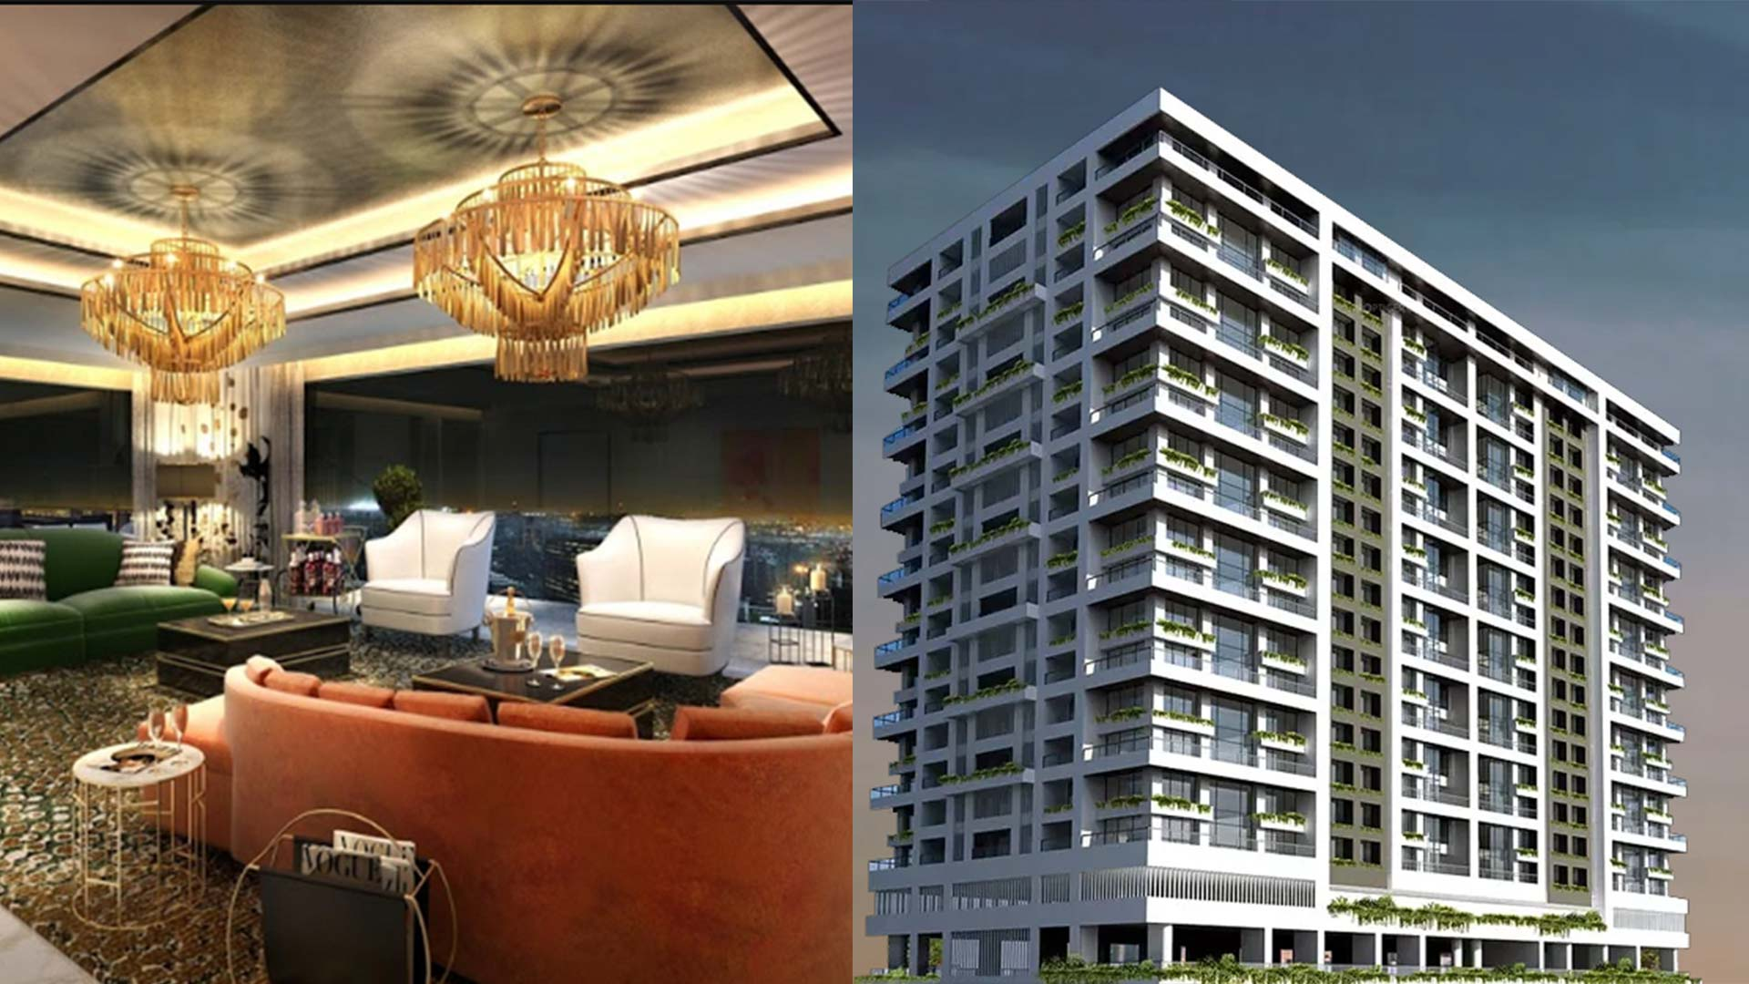
Best neighborhood to rent apartment in Bangkok
Coursera Capstone Project
Dhanashree Nangre

Slide 2
Introduction
Moving to a new area includes house hunting and ﬁnding a house in unfamiliar area is a major challenge. Conventional way of doing it is drive by your new neighborhood at night, before you move. Renting an apartment is a best option if a person is looking to settle at the place. This project will help people who are thinking of renting a apartment in Bangkok and instead of doing it by traditional way they want to do it smartly. This project will provide best possible options of neighborhoods with rent, apartment and neighborhood features information. They can look at comparison and decide. The results will be useful for people who are
• Planning to rent apartment
• Already rent a apartment
• have a apartment to they want put on rental list

Slide 3
Business Problem
The objective behind this project is to analyse and come up with best possible neighborhood options in the Bangkok to rent a apartment. Use data science and machine learning techniques with python to ﬁnd neighborhood which has more features which will make living more comfortable and pocket friendly.

Slide 4
Data
Below you’ll ﬁnd the data we need, data sources and descriptions of techniques we’ll be using to get that information.
List of neighborhoods and rental apartment in those: For rental apartment and neighborhood information we will use Thailand-property.com website. https://www.thailand-property.com/properties-for-rent/bangkok We will use web-scraping technique’s to extract information from website pages with help of python requests and beuatifulsoup packages.
Latitude and longitude of neighborhoods.: We will use python Geocoder package to get geographical coordinates of the neighborhoods
Venues in the neighborhoods: we’ll then use Foursquare API to get venue list for those neighborhoods. Foursquare has one of the largest database of 105+ million places and used by 125,000 developers.

Slide 5
Analysis

Slide 6
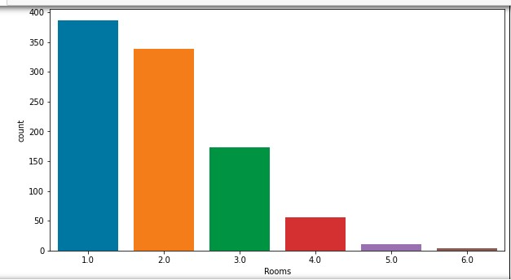
Number of apartments by Rooms

Slide 7
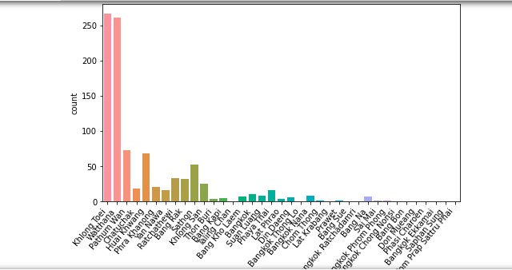
Number of apartments by Rooms

Slide 8
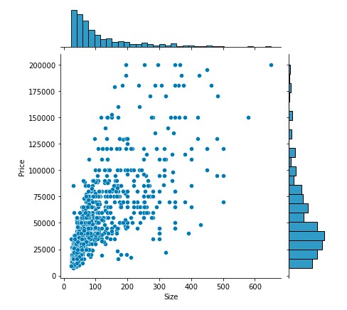
Correlation between price and apartment siz

Slide 9
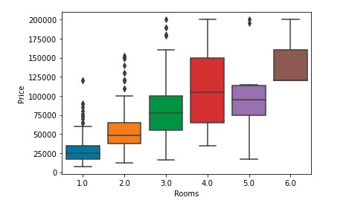
Graph showing relation between price and no of rooms

Slide 10
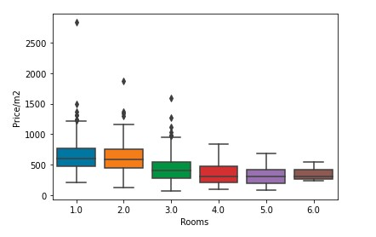
Graph showing relation between price and size of apartments

Slide 11
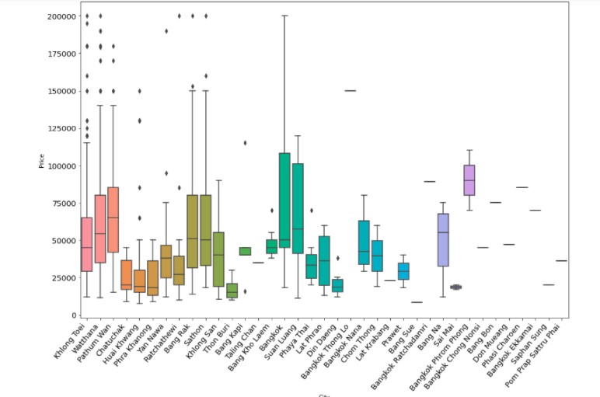
Graph showing relation between price and city

Slide 12
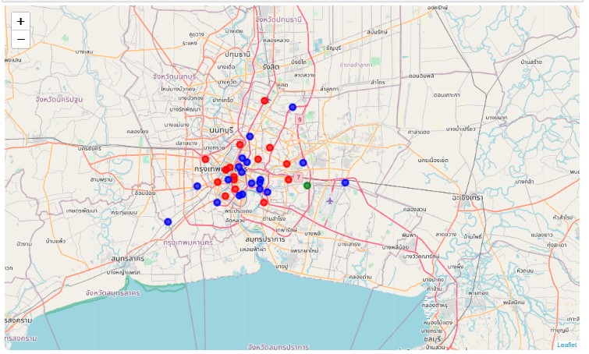
Result Of clustering

Slide 13
Conclusion
From results, it proves Cluster 1 has more more parks , supermarkets, gyms so it is more residential. Khlong Toei and Watthana are 2 cities from cluster 1 and they have most number of apartments options for rent. Chatuchak and Phra Khanong are the cities which have have low rent in cluster 1. These are the cities tat we can recommend a person which is looking for apartments to rent in Bangkok.

